Slide 1
Domain vs. Range and Rate of Change
Lesson 5-2

Slide 2
Domain vs. Range
The Domain of a function is the set of all possible x values (Inputs) which will make the function "work" and will output real y-values.
The Range of a function is the possible y values (Outputs) of a function that result when we substitute all the possible x-values into the function.

Slide 3
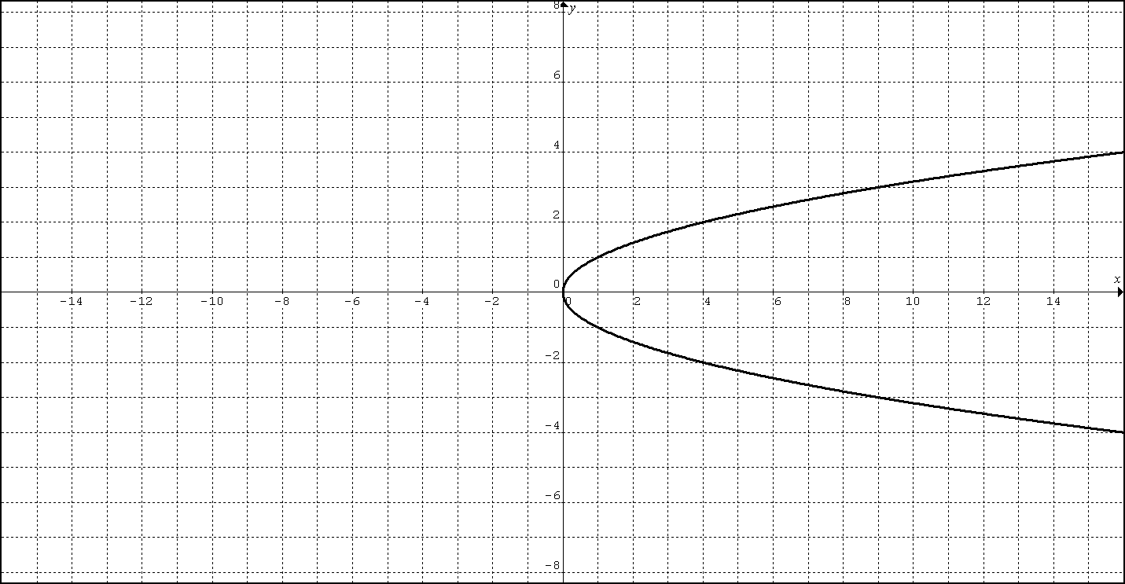
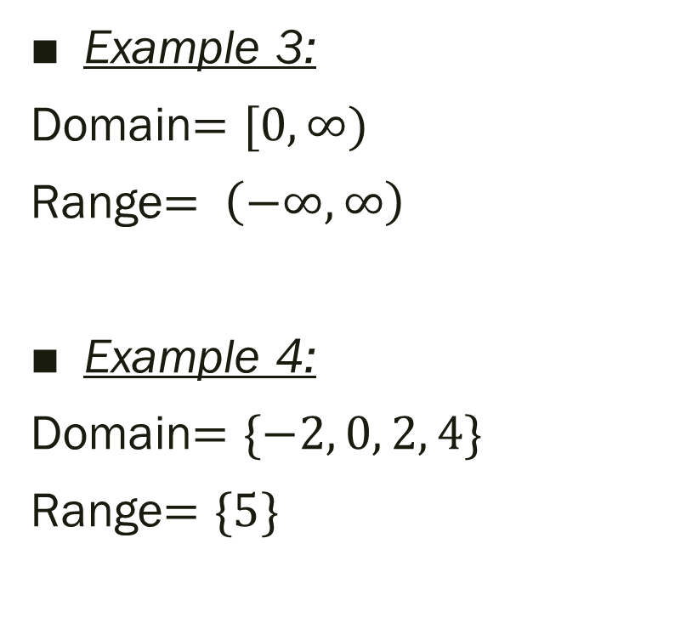

Domain vs. Range
Example 1:
Domain=$\left\{2, 3, 4\right\}$
Range=$\left\{3, 4, 5\right\}$
Example 2:
Domain=$\left\{7, 8, 9\right\}$
Range=$\left\{7, 8\right\}$
Example 3:
Domain$=[0, ∞)$
Range$= \left(−∞, ∞\right)$
Example 4:
Domain$=\{−2, 0, 2, 4\}$
Range$=\{5\}$
7
8
9
7
8
x | y
-2 | 5
0 | 5
2 | 5
4 | 5

Slide 4
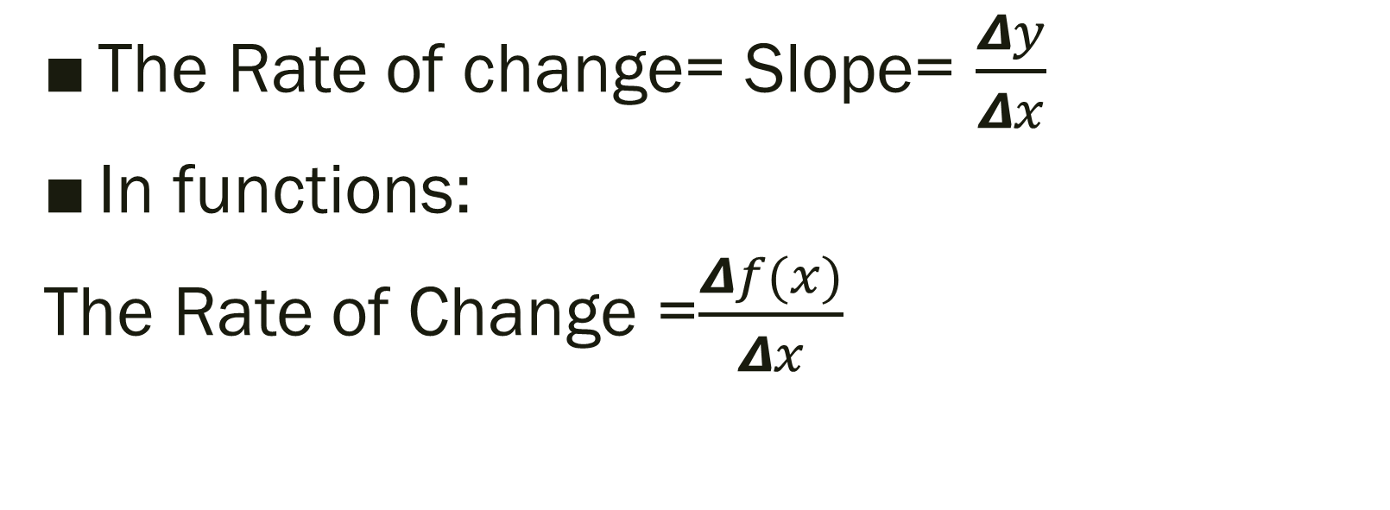
Average rate of change
The Rate of change= Slope= $\frac{Δy}{Δx}$
In functions:
The Rate of Change =$\frac{Δf(x)}{Δx}$

Slide 5
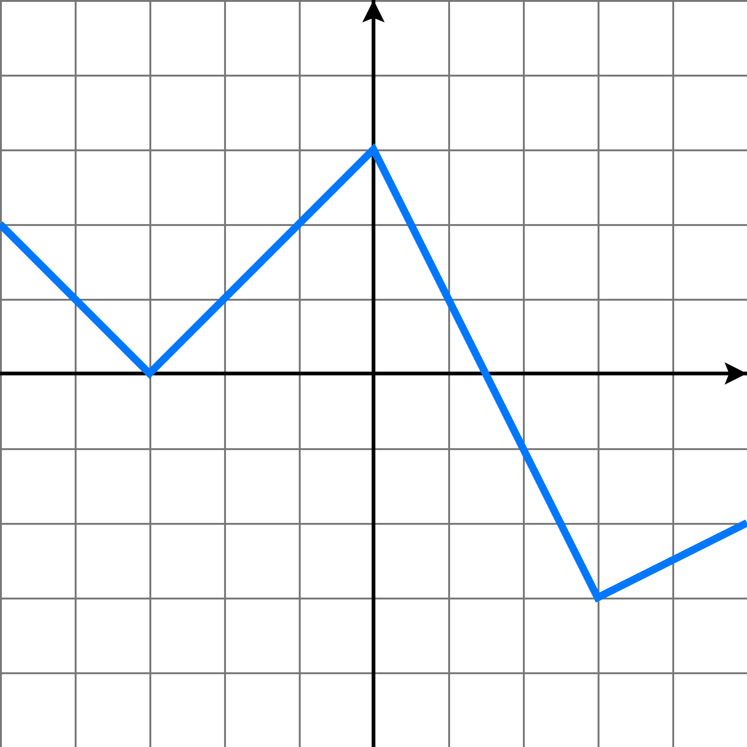



Find the average rate of change for the function over the interval:
$−3≤x≤0$
The Rate of Change =$\frac{Δf(x)}{Δx}$
=$\frac{f\left(0\right)−f(−3)}{0−(−3)}$
=$\frac{3−0}{0−(−3)}$
= $\frac{3}{3} =1$
$$Δ x=3$$
$$Δf\left(x\right)=3$$

Slide 6
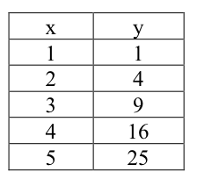



Find the average rate of change for the function over the interval:
$2≤x≤4$
The Rate of Change =$\frac{Δf(x)}{Δx}$
=$\frac{f\left(4\right)−f(2)}{4−2}$
=$\frac{16−4}{4−2}$
= $\frac{12}{2} =6$
$$4−2=2$$
$$16−4=12$$

